Slide 1

Kotlin Programming Language
A Modern Language for the JVM
Krishna.M
Pratyusha.K
Ranjith
Nikhil
Shivam.G

Slide 2
Agenda
Key Features
Names, Binding, and Scopes
Data Types
Expressions and Assignment Statements
Support to OO Programming
Exception Handling and Event Handling
Functional Programming
Null Safety and Interoperability with Java
Smart-Cast and Data Class
Conclusion
Concurrency

Slide 3
Key Features
Null Safety
Smart Casts
Extension Functions
Data Classes
Interoperability with Java

Slide 4
Names, Binding, and Scopes
Names refer to identifiers used to uniquely identify variables, functions, classes, and other program entities.
In Kotlin, names are case-sensitive, which means that ”helloWorld" and ”helloworld" are treated as different names.
Binding is the association between a name and the entity it represents in the program, such as a variable or a function.
In Kotlin, binding occurs when you declare and initialize a variable or define a function. For example:
val age = 25 // Here, 'age' is bound to the value 25
fun greet() { /* Function body */ } // function name 'greet' is bound to a function body

Slide 5
Static Type Binding (Compile-Time Type Checking):
Static type binding, also known as compile-time type checking, is the process of determining the data type of a variable or expression before the program is executed.
val number: Int = 42
val text: String = "Hello, World!"
// The types are known at compile-time, and any type violations will result in a compilation error.
Dynamic Type Binding (Runtime Type Checking):
Dynamic type binding, also known as runtime type checking, is the process of determining the type of an object or expression at runtime when the program is executed. This is typically associated with languages that use inheritance, interfaces, and polymorphism, such as Java or Kotlin.

Slide 6
open class Shape
class Circle : Shape()
class Square : Shape()
val shapes: List<Shape> = listOf(Circle(), Square())
for (shape in shapes) {
if (shape is Circle) {
println("Found a Circle!")
} else if (shape is Square) {
println("Found a Square!")
}
} The actual type of each object is determined at runtime, allowing you to make decisions based on the dynamic type of each object.

Slide 7
Scope refers to the region or context within which a name is valid and can be used.
Function Scope: Variables declared within a function are only accessible within that function.(Local Scope)
Block Scope: Variables declared within a block (e.g., if statements, loops) are limited to that block.
Class Scope: Member variables and functions declared within a class are in scope for all methods of the class.
Global Scope : Variables defined outside a function They are called global variables, and their scope is global.

Slide 8
Data Types
Data type : Every variable and expression has a type that determines what kind of values can be assigned to it. The main data types in Kotlin include.
Number, Character, Boolean, Array, String.
All values in Kotlin, including primitive types like Int and Boolean, are treated as objects. This means you can call methods and access properties on any variable.
val num = 10
print(num.inc()) // prints 11

Slide 9
Expressions and Assignment Statements
Expression Statements:
Are used to compute a value, which can be used in various contexts, such as assigning to a variable, passing as a parameter, or returning from a function.
val sum = 2 + 3 // The expression "2 + 3" computes a value and assigns it to the variable "sum."
Assignment statements
They are used to assign a value to a variable or a property. In Kotlin, you can use the = operator to perform assignments. The value on the right-hand side is evaluated as an expression, and the result is assigned to the variable on the left-hand side.
1)var x = 10 // Assigns the value 10 to the variable "x.” 2). val y = 2 * x// computing result based on x

Slide 10
Chained Assignment:
In Kotlin, you can perform chained assignment, where multiple variables are assigned in a single line, which can improve code readability.
var a = 5
var b = 10
var c = 15
a = b = c = 20 .// Chained assignment.
Overload Operators
Kotlin allows you to overload a set of predefined operators and create custom operators for your classes.

Slide 11
Fun main(){
val v1 = ExampleClass(10)
val v2 = v1.plus(11)
println(v2)
}
class ExampleClass(value:Int){
Operator fun plus(otherValue: Int): ExampleClass = ExampleClass(this.value + otherValue)
}
Output: ExampleClass(value =21)
when a function has a single expression in its body, you can omit the curly braces {} and use the =

Slide 12
Support to OO Programming
Object-Oriented (OO) programming is fully supported in Kotlin, a modern and concise programming language that combines object-oriented and functional programming features. Kotlin was designed to be fully interoperable with Java, which means it can leverage Java's extensive support for OO programming :
Class-Based: Kotlin is a class-based language, which means it supports class and object creation, inheritance, and encapsulation, core concepts of OO programming.
Classes and Objects: You can define classes and create objects in Kotlin just like in traditional OO languages. Kotlin's syntax for defining classes is concise and readable.

Slide 13
Example:
class Person {
var name: String = ""
var age: Int = 0
}
val person = Person(); //Object For Person Class.
Object Expression:
Object expressions Object expressions create objects of anonymous classes, that is, classes that aren't explicitly declared with the class declaration. Such classes are useful for one-time use. Instances of anonymous classes are also called anonymous objects because they are defined by an expression, not a name.
val helloWorld = object {
val hello = "Hello" val world = "World"
// object expressions extend Any, so override is required on toString()
override fun toString() = "$hello $world“
}

Slide 14
Inheritance: Kotlin supports class inheritance, allowing you to create subclasses and base classes. You can use the open keyword to indicate that a class is open for extension and then inherit from it using the : Base Class syntax.
open class Shape {
// ...
}
class Circle : Shape() {
// ...
}

Slide 15
Polymorphism: Kotlin supports polymorphism, enabling you to define functions or methods in base classes and override them in derived classes. It also allows the use of interfaces to achieve polymorphism.
open class Animal {
open fun makeSound() { }
}
class Dog : Animal() {
override fun makeSound() {
println("Woof!")
}
}
val puppy:Animal = Dog()
puppy.makeSound()

Slide 16
Abstraction: You can use abstract classes and functions in Kotlin to define abstract data types and methods that must be implemented in subclasses.
abstract class Shape {
abstract fun area(): Double
}
class Circle(val radius: Double) : Shape() {
override fun area() = Math.PI * radius * radius
}
class Rectangle(val width: Double, val height: Double) : Shape() {
override fun area() = width * height
}

Slide 17
Functional Programming –Core Concepts
Immutability in Kotlin:
In Kotlin, val is used for immutable variables and var for mutable ones.
val initialList = listOf(1, 2, 3)
// Creating a new list with an element added (immutability).
val newList = initialList + 4
println(newList) // [1, 2, 3, 4]
Higher-Order Functions:
Kotlin allows them to be assigned to variables and passed as arguments.
Higher-order functions take functions as parameters and can return functions.
fun operate(a: Int, b: Int, operation: (Int, Int) -> Int): Int {
return operation(a, b)
}
val result1 = operate(5, 3) { x, y -> x + y }
val result2 = operate(5, 3) { x, y -> x * y }

Slide 18
Lambda Expressions:
Lambda expressions provide a concise way to define anonymous functions.
They are integral to functional programming in Kotlin
val numbers = listOf(1, 2, 3, 4, 5)
// Using map, a higher-order function, to apply a lambda expression to each element.
val doubled = numbers.map { it * 2 }
val add: (Int, Int) -> Int = { a, b -> a + b }. //simple lambda
val result = add(3, 4) // result is 7
Pure Functions
fun add(a: Int, b: Int): Int {
return a + b
}
val result = add(3, 4)

Slide 19
Extending Functionality
Extension Functions:
Kotlin allows you to extend existing classes with new functions without modifying their source code.
This feature enhances code reusability and readability.
// Define an extension function for the String class
fun String.reverse(): String {
return this.reversed()
}
val originalString = "Hello, World!"
val reversedString = originalString.reverse()
println(reversedString) // Output: "!dlroW ,olleH"

Slide 20
Exception Handling and Event Handling
Exception handling is vital for managing errors and unexpected situations in your code.
try-catch Blocks:Use try to enclose code that may throw an exception.
catch allows you to handle exceptions, with options to catch specific exception types.
Example:
try {
// Risky code
} catch (e: Exception) {
// Handle the exception
}

Slide 21
Throwing Custom Exceptions:Employ the throw keyword to raise custom exceptions.
Example:
throw IllegalArgumentException("Invalid argument")
The finally Block:The finally block is used for cleanup operations, ensuring code executes, whether or not an exception occurs.
Example:
try {
// Code that may throw an exception
} catch (e: Exception) {
// Handle the exception
} finally {
// Cleanup code

Slide 22
Event Handling
Event handling is essential for responding to user interactions and asynchronous events in applications.
Listener Interfaces:Listener interfaces are used to define event handlers.
Implement these interfaces in classes to react to events.
Example:
interface ButtonClickListener {
fun onClick() }
class Button : ButtonClickListener {
override fun onClick() {
// Handle the button click event
}

Slide 23
Lambda Expressions:Kotlin offers concise lambda expressions for event handling.
This approach is common in modern GUI and Android development.
Example:
button.setOnClickListener {
// Handle the button click event
}

Slide 24
Null Safety and Interoperability With Java
Null Safety:
Kotlin enforces null safety, which means that the type system distinguishes between nullable and non-nullable references, reducing the risk of null pointer exceptions.
Example of nullable and non-nullable types:
val name: String = "John" // Non-nullable
val nullableName: String? = null // Nullable. Value can be Null
Advantage : val length = nullableName?.length.

Slide 25
Interoperability with Java:
Kotlin is fully interoperable with Java, meaning you can call Java code from Kotlin and vice versa. Here's an example of using a Java class from Kotlin:
Java class Person: Kotlin Code:
public class Person {
private String name;
public Person(String name) {
this.name = name;
}
public String getName() {
return name;
}
}
fun main() {
val person = Person("Alice") // Create a Java object
val name = person.name // Access Java method
println("Person's name is: $name")
}

Slide 26
Concurrency
Concurrency in Kotlin is achieved through various mechanisms and libraries that leverage Kotlin's concise and expressive syntax. Kotlin provides native support for handling concurrency, and it seamlessly integrates with Java's concurrency libraries.
Thread-Based Concurrency: Kotlin can work with threads and low-level concurrency constructs like Java's Thread class and Runnable. It also provides a simplified syntax for creating and managing threads.
val thread = Thread {
// concurrent code
}
thread.start()

Slide 27
Coroutines: Coroutines are a powerful feature in Kotlin for writing asynchronous, non-blocking code. You can create, launch, and manage coroutines using the launch, async, and await functions
import kotlinx.coroutines.*
fun main() {
runBlocking {
// This is a coroutine context
val job = launch {
delay(1000) // Simulate some asynchronous work
println("Coroutine is done."}
println("Main function continues while coroutine is still running.")
job.join() // Wait for the coroutine to complete}}

Slide 28
Smart-Cast and Data Class
DATA CLASS
data classes are a special type of class that are primarily used to represent data and carry no behavior. They are concise and automatically generate standard methods such as equals(), hashCode(), toString(), and more, making them well-suited for modeling data objects.
Eg: data class Person(val name: String, val age: Int)
Equals(): Compares two objects based on their property values.
hashCode(): Generates a hash code based on the properties.
toString(): Creates a string representation of the object in the format "ClassName(property1=value1, property2=value2, ...)".

Slide 29
Smart cast
Smart cast is a feature in which Kotlin compiler tracks conditions inside if expression. If compiler founds a variable is not null of type nullable then the compiler will allow to access the variable.
When we try to access a nullable type of String without safe cast it will generate a compile error.
var string: String? = "Hello!"
print(string.length) // Compile error
To solve Above isuue
var string: String? = "Hello!"
if(string != null) { // smart cast
print(string.length)

Slide 30
val obj: Any = "The variable obj is automatically cast to a String in this scope"
if(obj is String) { // No Explicit Casting needed.
println("String length is ${obj.length}")
}
Use of !is for smart cast
fun main(args: Array<String>){
val obj: Any = "The variable obj is automatically cast to a String in this scope"
if(obj !is String) {
println("obj is not string")
} else
// No Explicit Casting needed.
println("String length is ${obj.length}")
}

Slide 31

LandMark Master
Landmark recognition is the process of identifying distinctive features or notable landmarks within images or video frames. This capability empowers applications to deliver contextual information derived from visual input.
For instance, it excels at recognizing iconic structures, monuments, and natural landmarks.
Additionally, this application offers sign in features, further enhancing its educational and interactive capabilities.

Slide 32

LandMark Master
Utilized Technologies
Kotlin : Employed for application development In Android.
TensorFlow Lite : Utilized for advanced landmark recognition.
CameraX : Implemented for streamlined and efficient camera interaction.
Firebase : was incorporated to facilitate seamless user authentication For Sign In Capabilities .
Development environment : Android studio

Slide 33
Workflow
Input Acquisition from a camera
Frame Converted to Tensor Image:
The Video or Image Acquired by the CameraX module is sent as Frames to TensorFlow which converts the frames to bitmap which are classified by TensorFlow AI model.
Landmark Recognition using TensorFlow Lite model:
The Main Reason to choose Lite version is it is designed to work in a optimized way for Mobile Devises with less over head and limited Processing power .
Model Inference and Probability Assessment
The Model considers some parameters like Threshold (0.5F) its bound to recognize and send in the output if its only above 50% Confidence and Maxresults =[1,2,3…] meaning its can display the up to the given integer number of classification if confidence is >= threshold. In our model its set to 1 .
Landmark Name Retrieval: Model shows the Text based on bitmap with high Probability match.

Slide 34
Constraints
TensorFlow Lite, while efficient, may not always deliver perfect results due to limited computational resources.
Lite models are chosen to optimize performance on mobile platforms.
High processing requirements may lead to increased latency in providing recognition results.
The application cannot discern if it is processing live camera feed or static images.

Slide 35

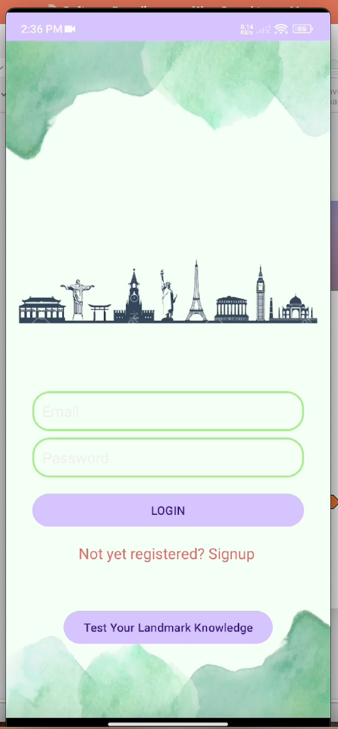
SIGN UP Integrated with firebase for Authentication
LOG IN
After registration/ Sign UP the user is able to login with authentication

Slide 36

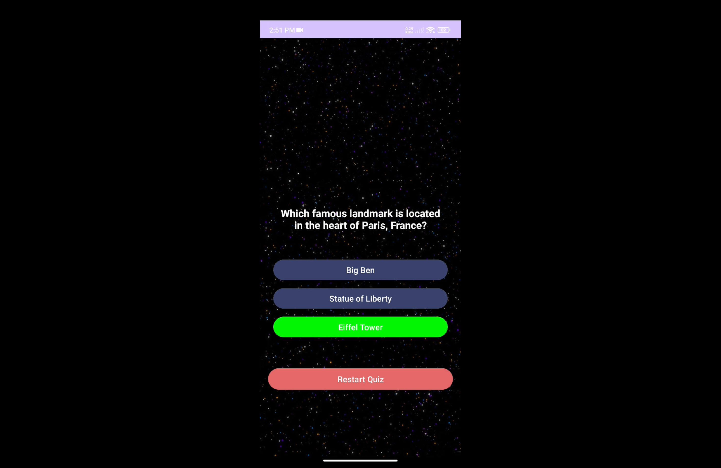
QUIZ FUNCTIONALITY
Users Can Take-up Quiz and answer questions to test themselves on the places

Slide 37
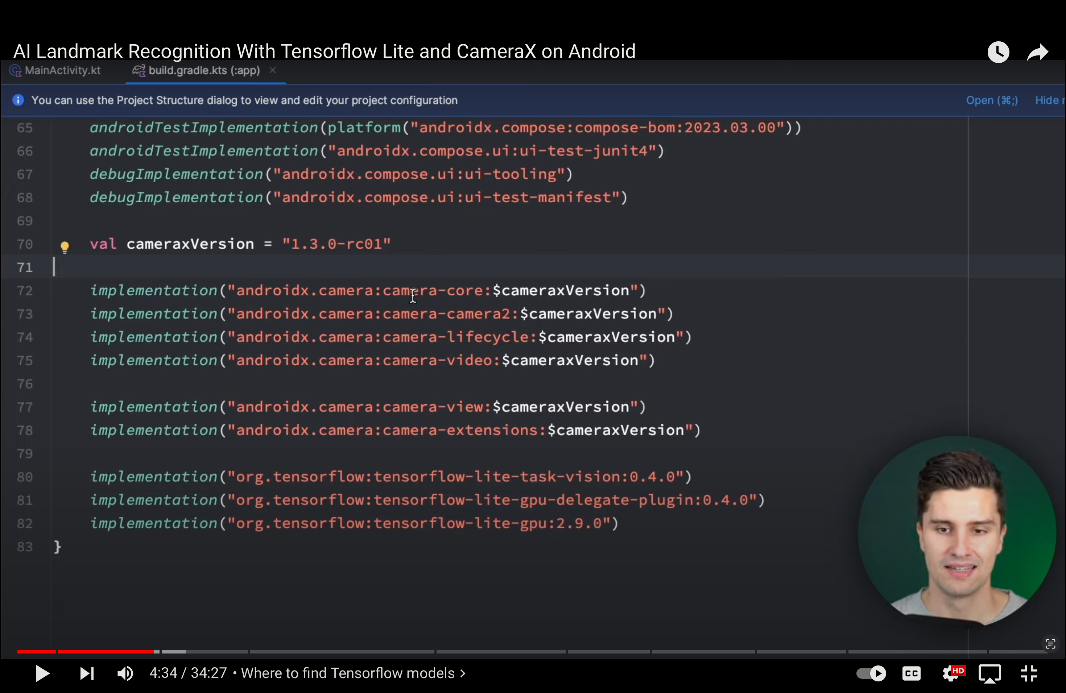
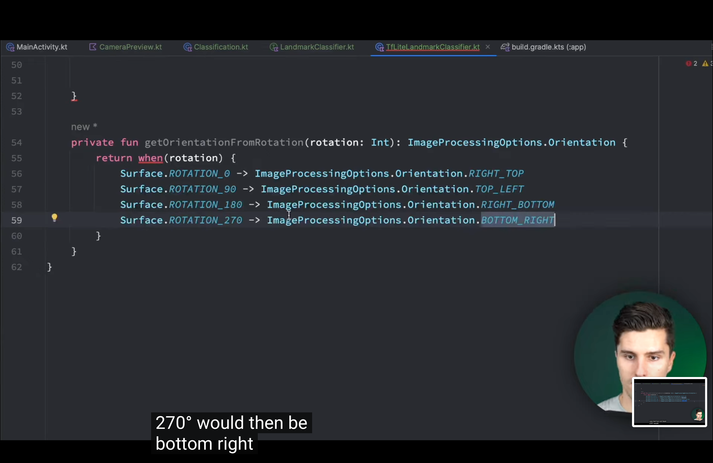
Dependencies and Camerax Working
Cropping and Setting Boundaries so Model can understand Image and Giving square Constraint to capture frames

Slide 38

LandMark Master
Name : Buckingham palace
Confidence Score : > 0.5

Slide 39

Video Of App Demonstrating The Working.
https://github.com/sai991/CSCI_6221-KOTLIN

